Slide 1
examwand -THE FUTURE OF ONLINE LEARNING PLATFORMS
By
BYTE TRIBE:

Slide 2
Introduction
In a year of unforeseen circumstances there has occurred a surge in the use of technology to meet necessary activities. To an extent this change has made life easy for many of us, but teachers are faced with the arduous task of correcting answer papers virtually. To overcome these hassles we have developed a viable solution.
We are making an attempt to reinforce the future of online learning platforms, that eases the stress and hardships faced by teachers in correction and also to improve learning experience for students. An app ,that integrates various features from existing learning platforms, like pdf document creation and classrooms along with new features like in-app answer script correction method by entering a sample answer.

Slide 3
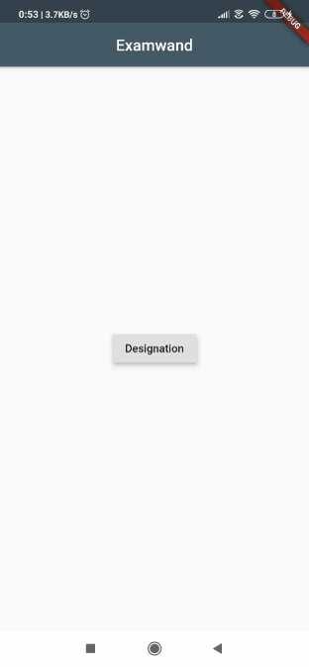
Implementation
The UI framework is implemented using flutter with dart as the programming language for fronted and python framework, flask for certain backend tasks. Initially, we created two separate interfaces for the teacher and student. Features like text recognition, pdf creation and text editing have been added to both.

Slide 4
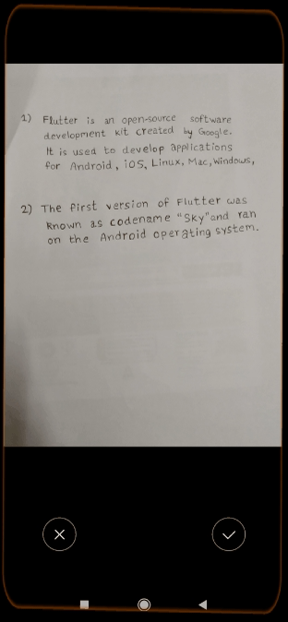
The image is clicked using ‘image_picker’ package and the text within the image implements text recognition using Flutter Firebase ML Kit. Errors in the recognized text can be rectified using the edit block. This text is then converted to a pdf.

Slide 5
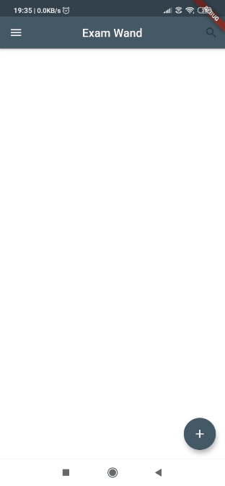
We have tried to accomplish something similar to the concept of classrooms implemented by google. A random code is generated on the teacher’s interface with which students can join the classroom. The teacher can enter the name of the classroom according to their convenience for ease of access in future.

Slide 6
Then the generated pdf is sent to the teacher for evaluation, wherein, each answer is stored as elements of an array of type ’String’. After which the similarity between the answer key uploaded by the teacher and the answer sheet of the student is compared. Based on this evaluation, a percentage is obtained that helps determine the score of the student.

Slide 7
Future Plans
In future, we intend to increase efficiency by integrating more features into the mobile application like tools to detect plagiarism and create online interactive classrooms, assignment submission platforms and to conduct short tests. We also aim to make it user-friendly to facilitate the comfort and convenience of the users.

Slide 8
TEAM MEMBERS:
Shwetha Jayan
Maria Rachel Joseph
Angela Tony
Dona Yeldho

